Slide 1
Analysis of Employment Rate using Time Series
Group 216:
Ridhima Bhalerao (A20422550)
Akhil Padgilwar (A20427219)

Slide 2
INTRODUCTION
Employment rate determines the percentage of working population in the entire population of a country.
Employment rates have a significant impact on the country’s economy. But, the workforce of a country may be biased based on the gender, age, etc.
One of the factors that affect the employment rate is the gender inequality. To explore if the problem persists, has motivated us to take up this project.
To achieve this, we have built a time series model to gauge the employment rate based on the gender for multiple years.

Slide 3
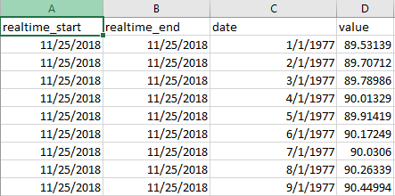
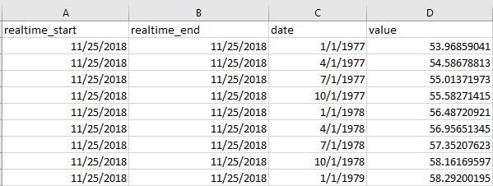
DATASET
Our data had 2 files:
Employment Rate for Males
From year 1977 – 2018 →
2. Employment Rate for Females
Independent variable: date
Dependent variable: value

Slide 4
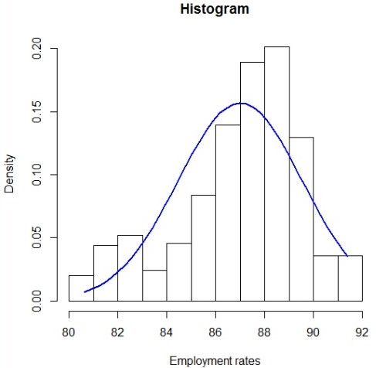
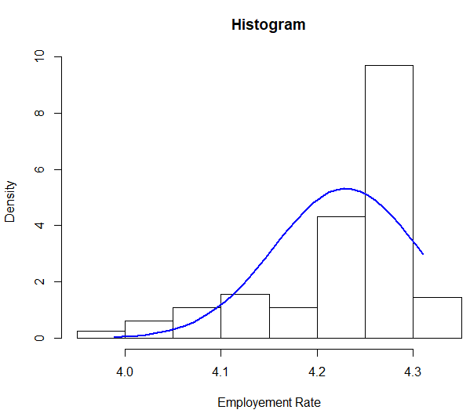
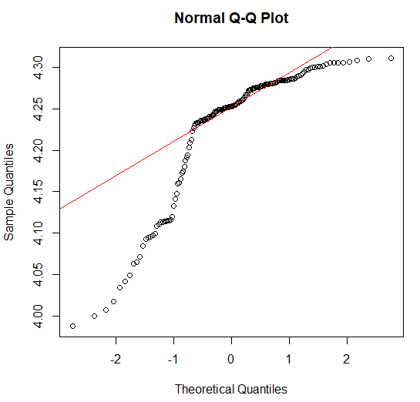
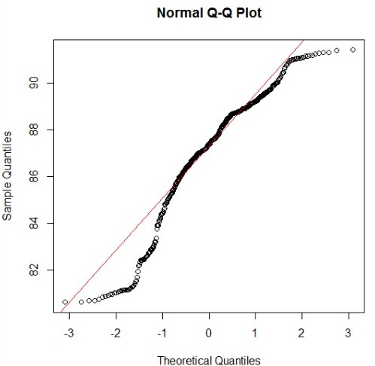
Testing the normality
Male: Female:

Slide 5
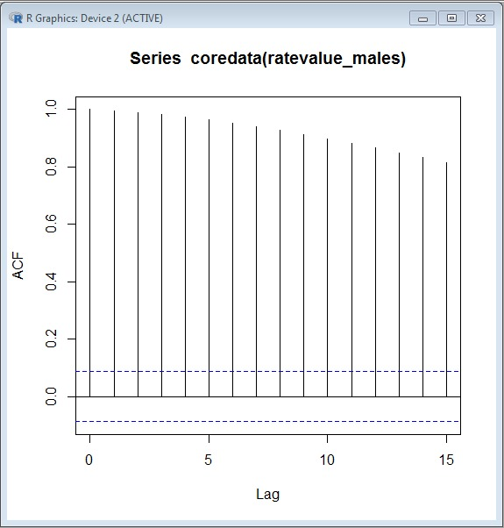
Is it stationary?
The decay rate is very slow, thus, the data is non-stationary!

Slide 6
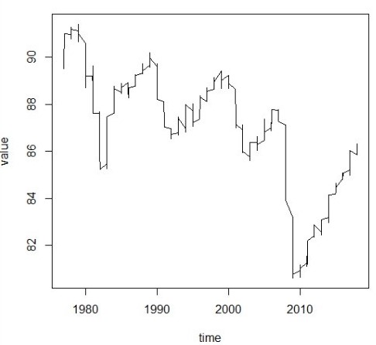
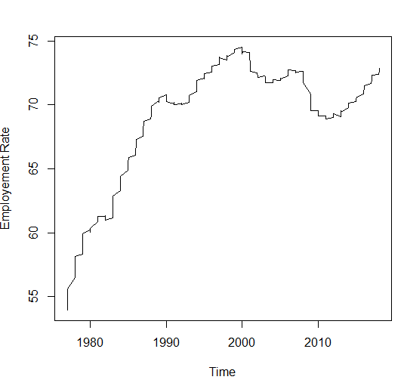
Plotting Time Series
Male: Female:

Slide 7
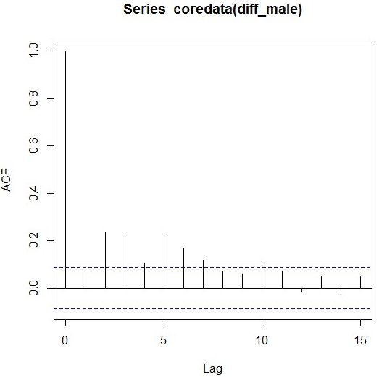
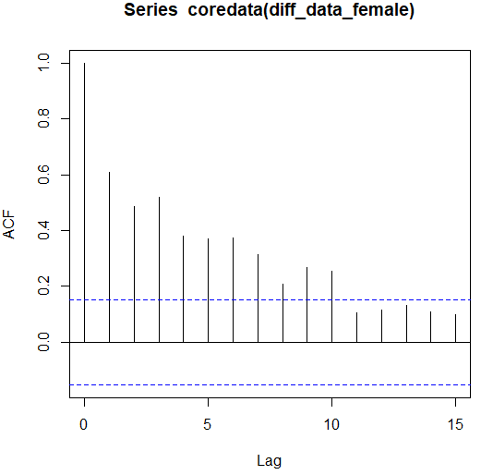
Transformation
ACF Plot Male: ACF Plot Female:

Slide 8
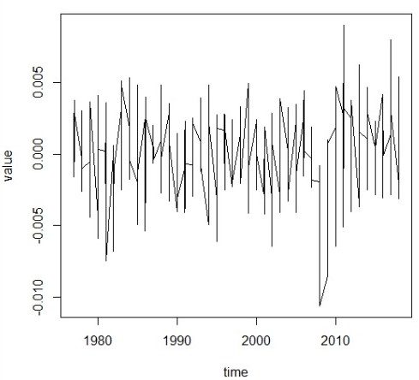
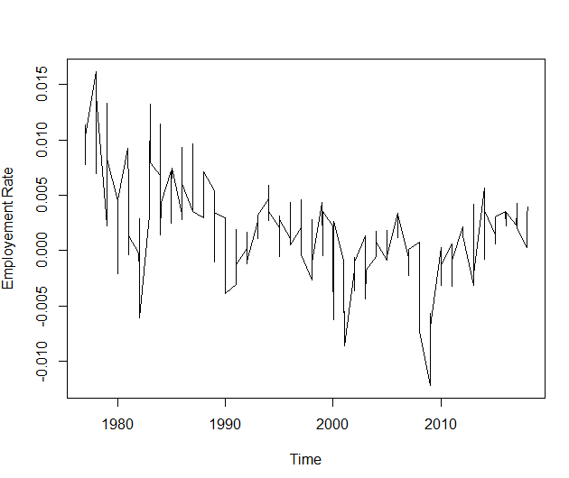
Transformed Time Series Plot
Time plot for Male: Time plot for Female:

Slide 9
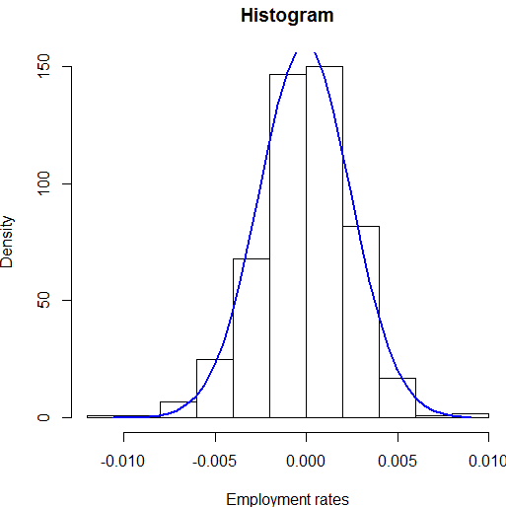
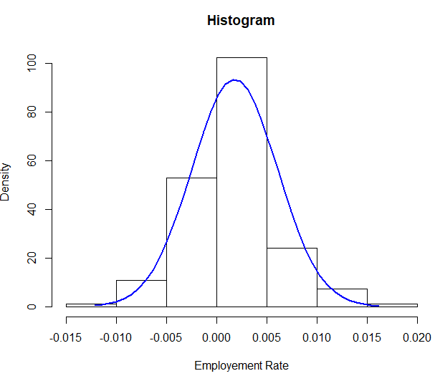
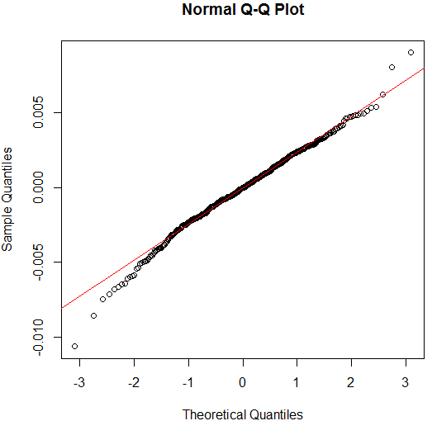
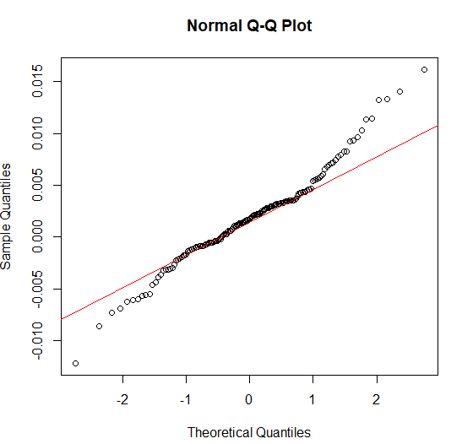
Histograms & QQ Plot
Male: Females:

Slide 10
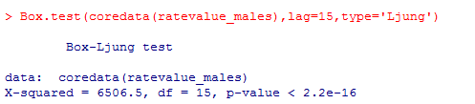
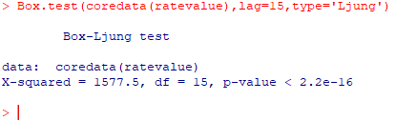
Is serial correlation present?
Ljung box test:
Null Hypothesis (Ho) : Autocorrelation values for lag 1…k i.e. 1…15 are zero.
Alternative Hypothesis (Ha) : At least one autocorrelation value for lag 1…k i.e. 1….15 is non- zero.
Since, the p-value is less than 0.05, we can conclude that the data exhibits serial correlation.
Hence, we reject the null hypothesis.

Slide 11
Is there seasonality?
For the seasonality, the ACF plot must have lag 1, lag s-1, lag s and lag s + 1 must be significantly non-zero.
In this case, lag 1 is non-zero, but lag 11, lag 12 and lag 13 are significantly zero.
Thus, no seasonality is present.

Slide 12
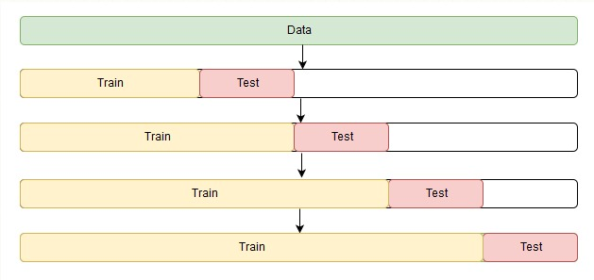
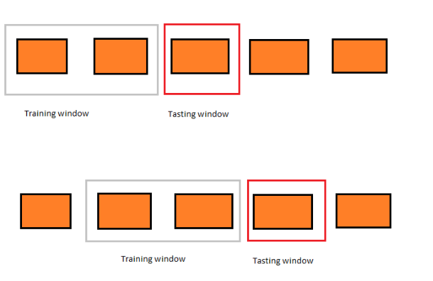
Validation Strategy
Since our dataset had less data, we have used rolling origin to split the data into train and test data.
Strategies:
1. Increasing Time Window
1977 – 1987 : Train window 1
1988 : Test Window 1
1977 – 1997 : Train window 2
1998 : Test Window 2 and so on…
2. Moving Time Window

Slide 13
Models
We have built models based on every train window
For the first window we have built models using all the methods used to find p and q
Method 1: Manually finding p and q values
Method 2: Extended Auto-Correlation Function(EACF)
Method 3: Automatically finding the p and q values

Slide 14
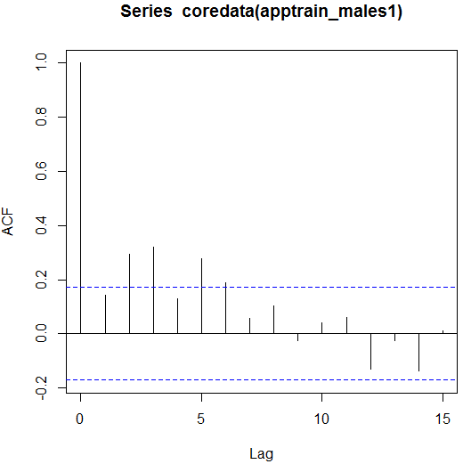
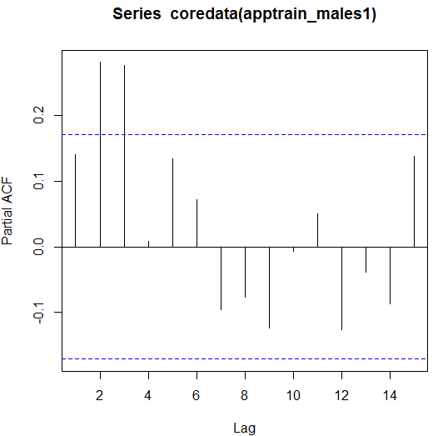
Manually identifying p and q values
ACF plot: PACF plot:

Slide 15
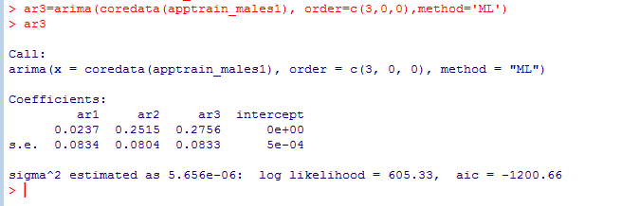
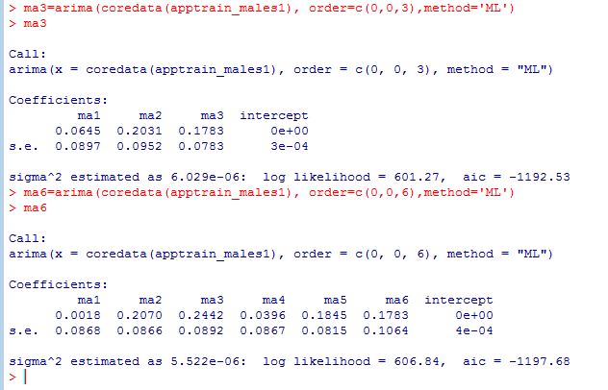
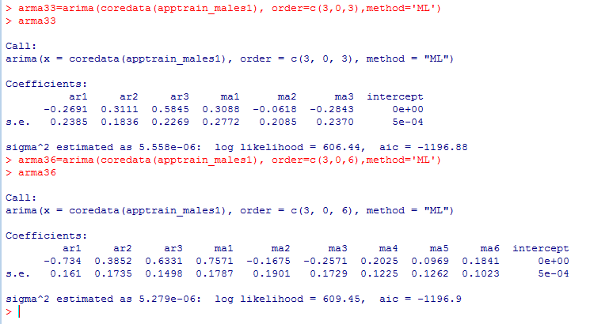
Models: AR(p),MA(q) and ARMA(p,q)
AR(3): MA(3) & MA(6): ARMA(3,3) & ARMA(3,6):

Slide 16
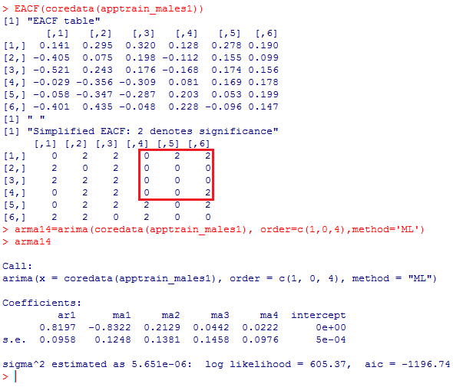
Using EACF
Here, we can see that p = 1 & q = 4, hence, we build ARMA(1,4) model.

Slide 17
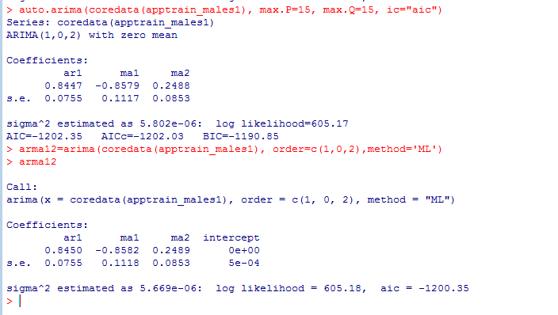
Using auto.arima()
By auto-arima() determines p and q
values automatically. Here, p = 1
and q = 2, so we build ARMA(1,2)
model.

Slide 18
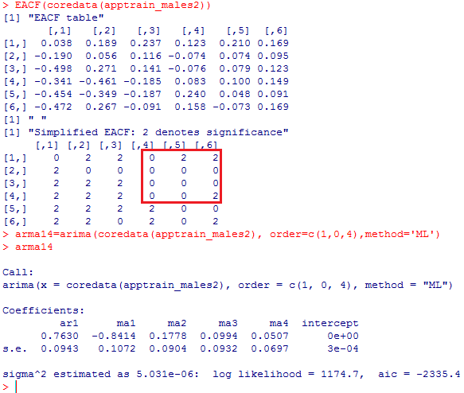
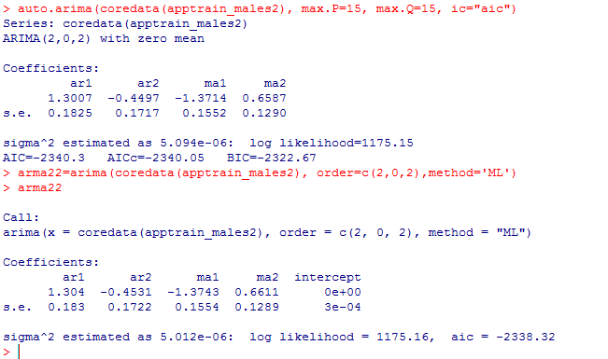
Models for window 2
EACF
Auto.arima()

Slide 19
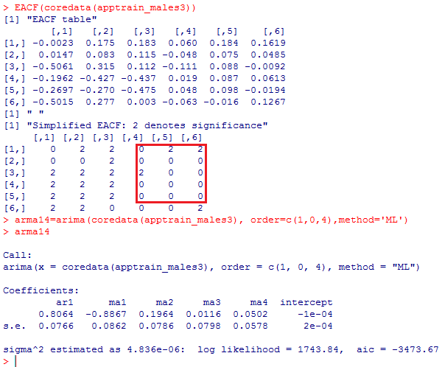
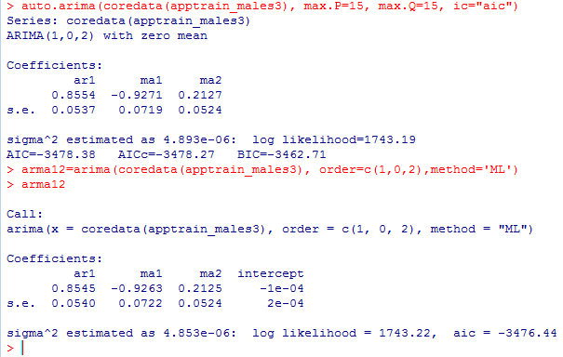
Models for window 3
EACF: auto.arima():

Slide 20
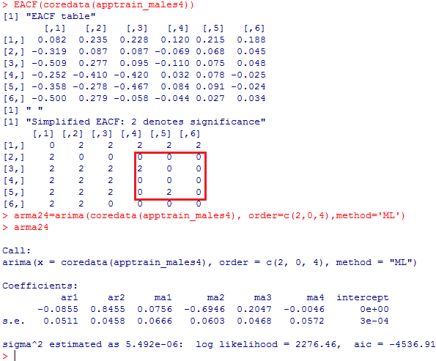
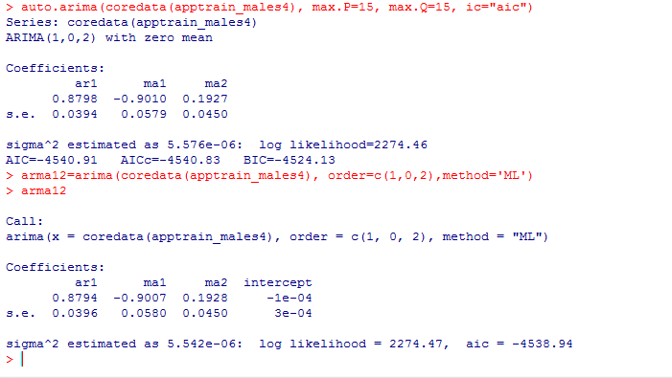
Models for window 4
EACF: auto.arima():

Slide 21
Models available for comparison
These are all the models available for comparison from all the folds:
SR No. | Model | AIC | Window
1. | AR(3) | -1200.66 | Window1
2. | MA(3) | -1192.53
3. | MA(6) | -1197.68
4. | ARMA(3,3) | -1196.88
5. | ARMA(3,6) | -1196.90
6. | ARMA (1,4) | -1196.74
7. | ARMA (1,2) | -1200.53
8. | ARMA (1,4) | -2335.4 | Window2
9. | ARMA (2,2) | -2338.32
10. | ARMA (1,4) | -3473.67 | Window3
11. | ARMA (1,2) | -3476.44
12. | ARMA (2,4) | -4536.91 | Window4
13. | ARMA (1,2) | -4538.94

Slide 22
Predicting and Evaluating models based on test data
Since we’d applied differencing on the data, so we build ARIMA models based on the original data to produce predictions based on the test data.
AR(3) → ARIMA(3,1,0)
MA(3) → ARIMA(0,1,3)
MA(6) → ARIMA(0,1,6)
ARMA(3,3) → ARIMA(3,1,3)
ARMA(3,6) → ARIMA(3,1,6)
ARMA(1,2) → ARIMA(1,1,2)
ARMA(1,4) → ARIMA(1,1,4)
ARMA(2,2) → ARIMA(2,1,2)
ARMA(2,4) → ARIMA(2,1,4)

Slide 23
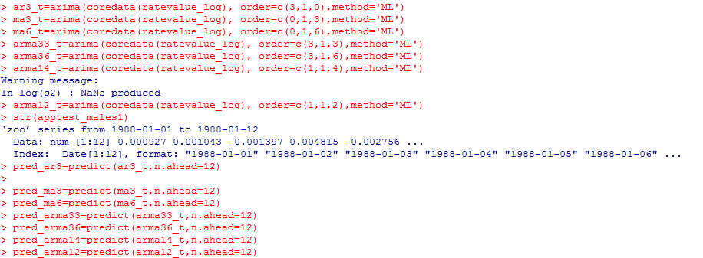
ARIMA Models
ARIMA models on the data before differencing are as follows:

Slide 24
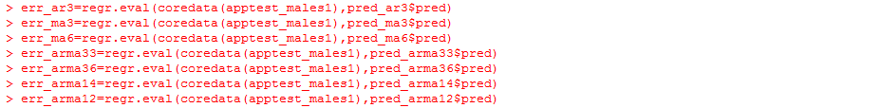
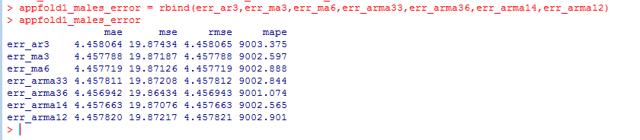
Calculating Prediction Errors
Errors can be calculated as follows:
Errors:

Slide 25

Which is the best model?
Based on the same process, we calculate errors for all the data folds. From that, we have chosen one best model from each fold.
SR No. | Model | MAE values | Window
1. | ARMA(3,6) | 4.456942 | Window1
2. | ARMA(1,4) | 4.457438 | Window2
3. | ARMA(1,4) | 4.461118 | Window3
4. | ARMA(2,4) | 4.457336 | Window4
Average MAE value: 4.4582085
Equation for ARMA(3,6) model:

Slide 26
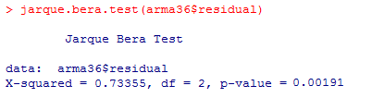
Checking Normality of ARMA(3,6) model
Jarque Bera Test:
Since, the p-value is less than 0.05, we can conclude that the model follows normality.

Slide 27
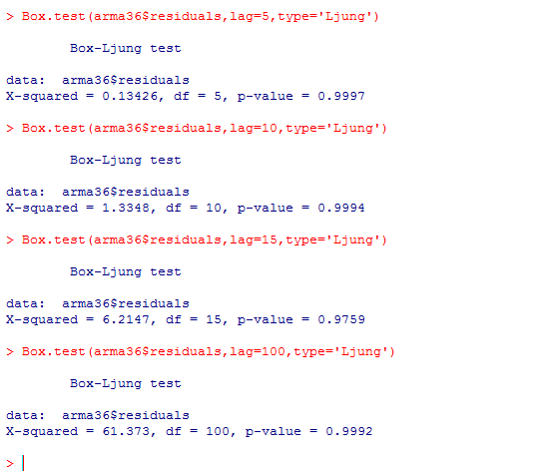
Validating the ARMA(3,6) model
Ljung Box Test:
Even though the lag is 5 or 100, the p-value is greater than 0.05, thus, we can say that, it has white noise and our model is qualified.

Slide 28
Best model for Female Employment Rate
After following the same approach on the female data, we have achieved following 4 best models for each window:
SR No | Model | MAE values | Window
1. | MA(1) | 4.285532 | Window1
2. | ARMA(2,3) | 4.294498 | Window2
3. | ARMA(2,3) | 4.2975 | Window3
4. | ARMA(2,2) | 4.2912 | Window4
Average MAE value: 4.2921825
Equation for MA(1) model: Xt – intercept = β1(Xt-1 – intercept) + at
Xt – 0.0057 = 0.4180(Xt-1 – 0.0057) + at
Xt = 0.4180Xt-1 – 0.0080826 + at

Slide 29
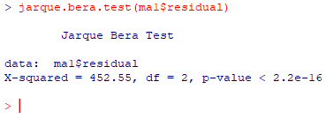
Checking Normality of MA(1) model
Jarque Bera Test:
Since, the p-value is less than 0.05, we can conclude that the model follows normality.

Slide 30
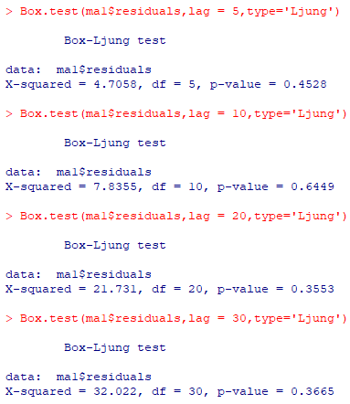
Validating the MA(1) model
Ljung Box Test:
Even though the lag is 5 or 30, the p-value is greater than 0.05, thus, we can say that, it has white noise and our model is qualified.

Slide 31
Is there discrimination during employment?

Slide 32
Conclusion and Outcomes
In this way we have implemented time series analysis and time series forecasting.
By observing time series plot of male and female, we determined that male employees have highest employment rate than female employees.
By using increasing window approach and moving window approach, we found the best model to predict future employment rate of male and female employees.
We have implemented different ACF plot and the time series plots to conclude that there is no seasonality in our data.

